Slide 1
Linux – Command Line Skills

Slide 2
Why do we need CLI
Linux admin
Network admin
DBA CLI
Windows admin - Powershell

Slide 3
The Shell
What IS “the shell”?
Essentially, a command line interpreter
A bit of history…
Sh – bourne shell, “the original”
Csh – C shell, written as part of BSD
Ksh – developed at Bell labs
Bash – today’s standard shell
Many others…

Slide 4
Login Process
System boot / Initialization completes
getty (get tty / terminal) process starts
User presented with login prompt (username / password)
Login process runs
Checks submitted username in /etc/passwd
Creates password hash based on username and password entered by user
Compares password hash against hash in /etc/shadow
If username and password match, login is successful
Shell process is created based on /etc/passwd
User ID
Primary and supplemental Group ID(s)
Home directory location
Terminal shell
Shell properties loaded from configuration files in user home directory and /etc
Prompt displayed and user can interact with system

Slide 5
Where am I and what am I doing?
Where am I?
pwd = print working directory
What’s in here?
ls = list (and a whole bunch of flags)
I want to move out of here
Relative vs. absolute
. and ..

Slide 6
File management
What do you do with files?
Create – touch
Delete – rm
Copy – cp
Move – mv
Rename – mv

Slide 7
Directory management
What do you do with directories?
Create – mkdir
Remove – rmdir
Move them – mv

Slide 8
File Ownership and Permissions
UGO = User / Group / Other
RWX = Read / Write / eXecute
File Ownership
Change owner - chown
Change group - chgrp
File Permissions
Modify permissions - chmod

Slide 9
File and Directory Ownership and Permissions
ls –la
-rwxrw-r-- 10 root root 2048 Jan 13 07:11 afile
First row “–” represents that this is a file a “d” is directory an “l” is a link
Second row --rwxrw-r– represents file permissions. Owner has rwx, group has rw, and other/everyone have r.
Third row -- 10 means the number of links,
Fourth -- row owner name and group name
Fifth row -- file size in kb
Sixth row – time of last modification
Seventh row – file/directory name

Slide 10
File and Directory Ownership and Permissions
Lets do the following;
Create a file
Create a directry
Change ownership of the group on the directory
Change owenership of the user on the file
The file should have rwx for owner, rw for group and no permissions for other. Do the same for the Directory

Slide 11
Extended Permissions - ACLs
Access Control Lists
Get file ACL – getfacl
Set file ACL – setfacl

Slide 12
Handling files
grep host domain.xml
more file.txt will display the contents of the file one page at a time
less table1 will display the top of the file up/down arrows to scroll or type line number and g to go back to beginning type g
sort names.txt will sort the file which has names in it in alphabetical order
diff file1 file2 highlights the differences between the two files

Slide 13
Commands
du will display the size of each content in the directory. Hard to read so use du –ah will show u size in kb mb etch
df provides disk space, used, available, and mounts. Use df –h
head file.txt will read the first few lines and writes to STOUT. If you want more lines then do head –n15 filename
tail file.txt –n 100 shows the last 100 lines or tail -f file.txt displays the last 10 lines but keeps feeding the screen as file is updated live
at time enter then enter your command this will schedule the job to run at that time

Slide 14
Commands
Tape Archive:
tar xvf extracts
tar cvf creates a tar file:
tar –zcvf /home/files.tar /home/jjohn/Files
File Compression:
gzip compresses a file
gunzip expands

Slide 15
Commands
alias p=”pwd” - user enters p and the pwd command runs
unalias p will remove the p to pwd mapping
swapon used to specify devices which paging and swapping are going to take place

Slide 16
Redirection
mail me < my_letter.txt – input operator
echo “test” > test.txt – output operator
echo “123” >> test.txt – append operator
| pipe allows you to take the standard out from the preceeding command to be the input of the following command

Slide 17
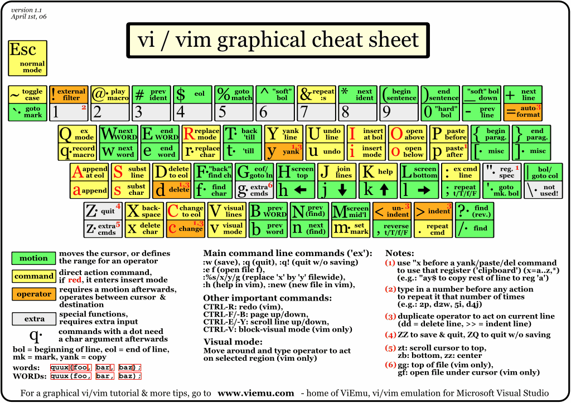
Vi / vim

Slide 18
Lab 4 Exercise

